Slide 1


Greg’s Bakery
Website Presentation
Ryan Kok, QB8J66C71

Slide 2
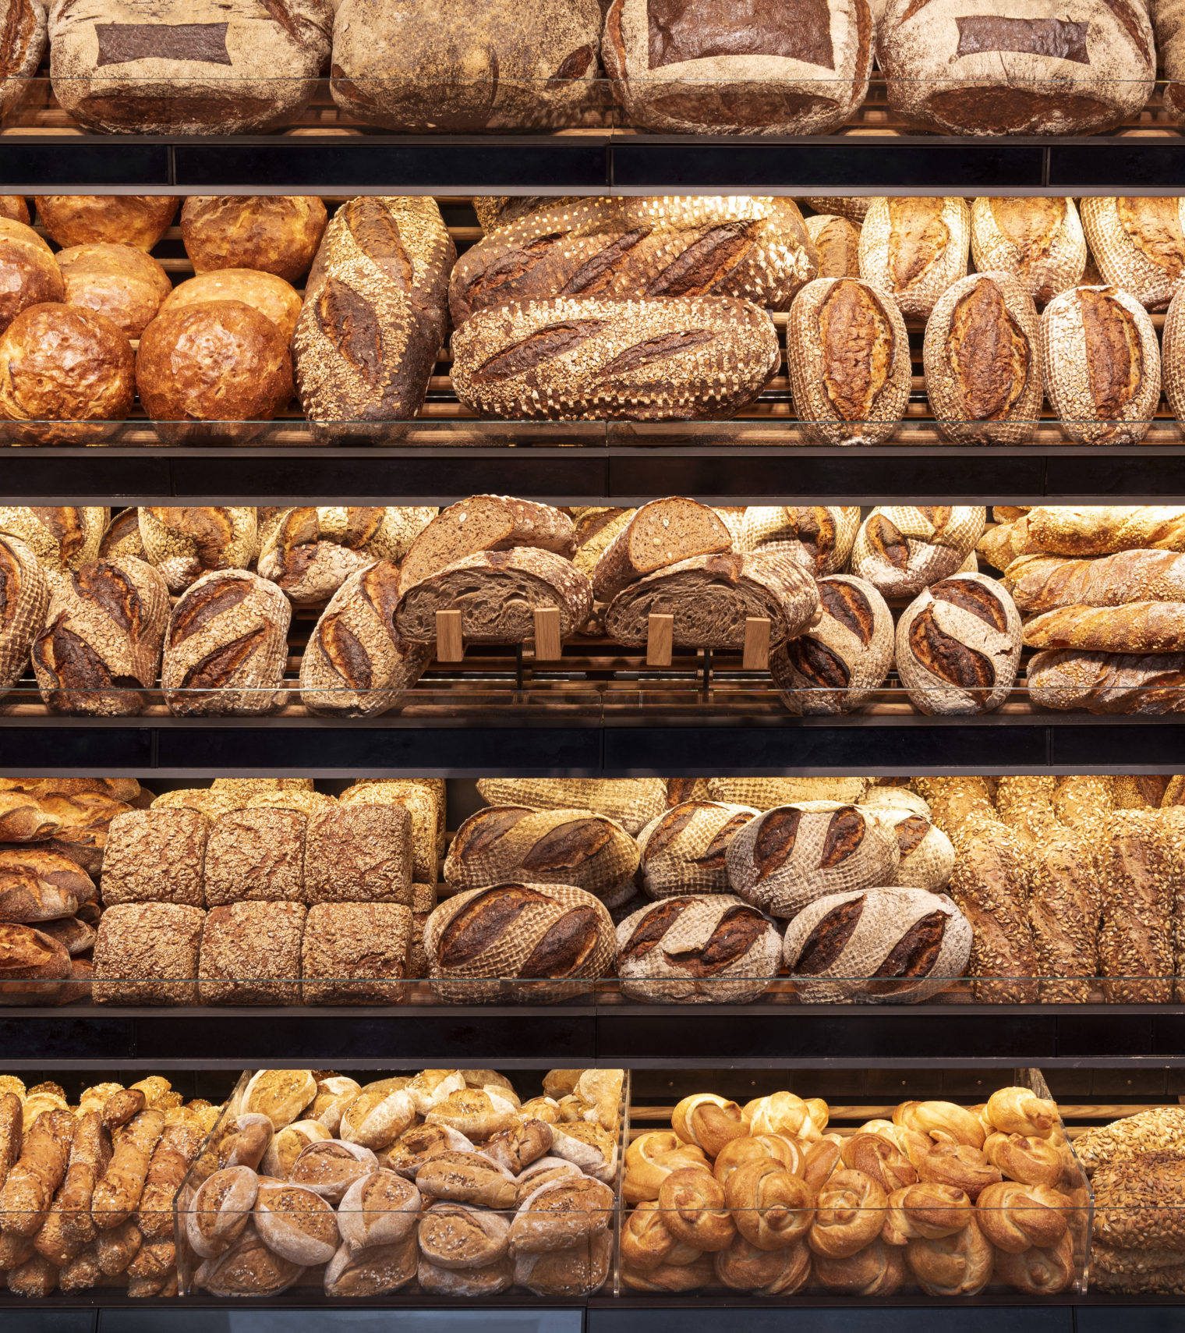

Introduction
Greg’s Bakery:
Established 2001
Sell baked goods
Custom cakes

Slide 3
Problems
Declining sales
Social media presence
Food delivery services
Extra costs

Slide 4
Solutions
Website
Show off products
Draw attention
Online orders
Pick-up in person
No online payments

Slide 5
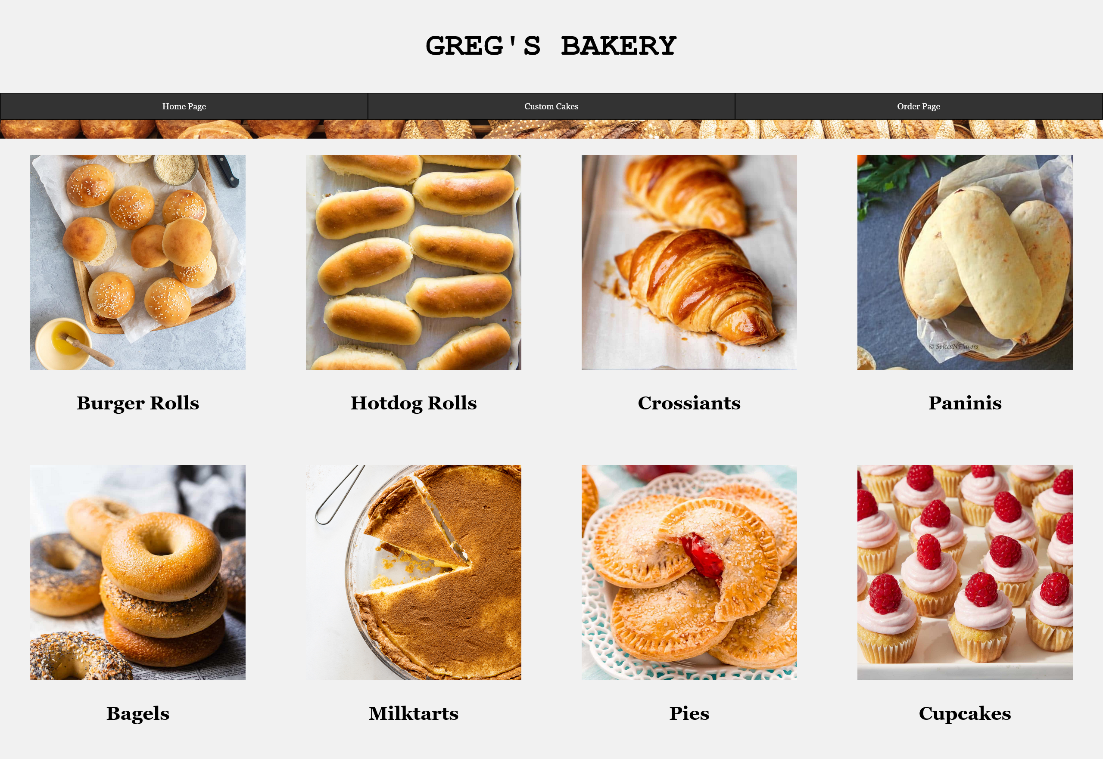
Homepage

Slide 6
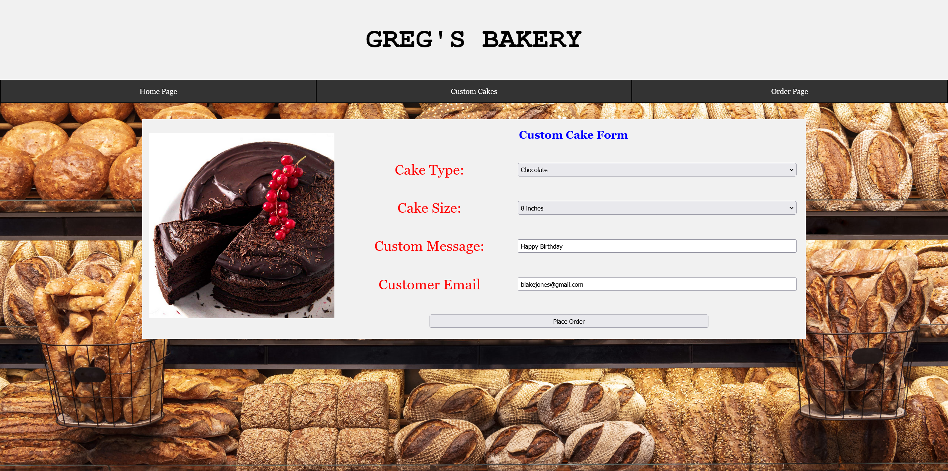
Cakes Orders

Slide 7
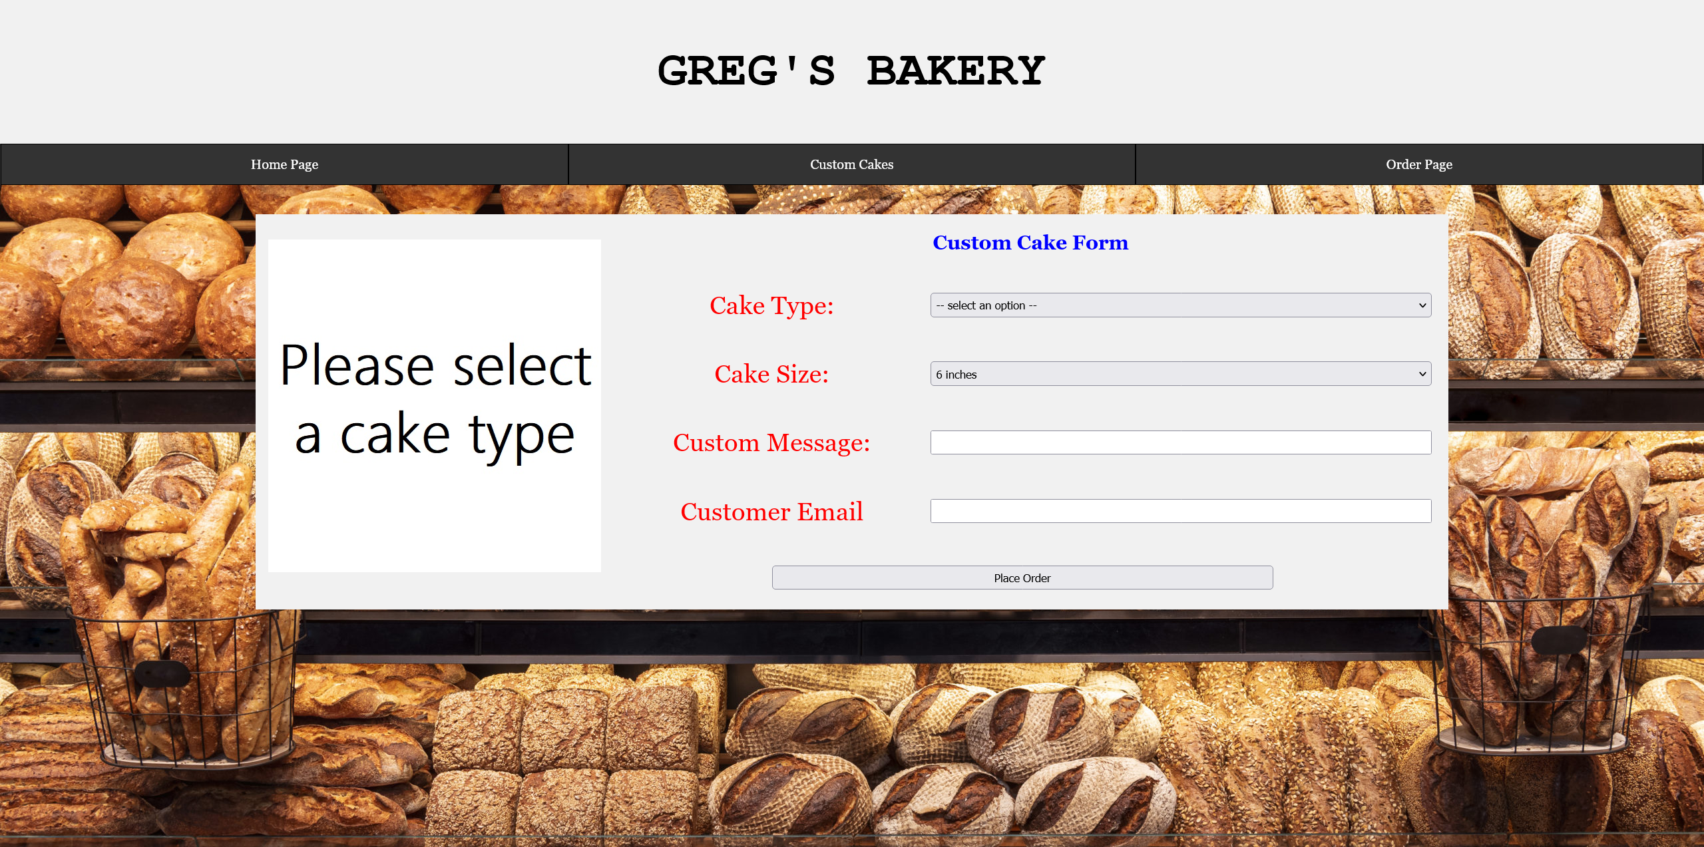
Bulk Orders

Slide 8
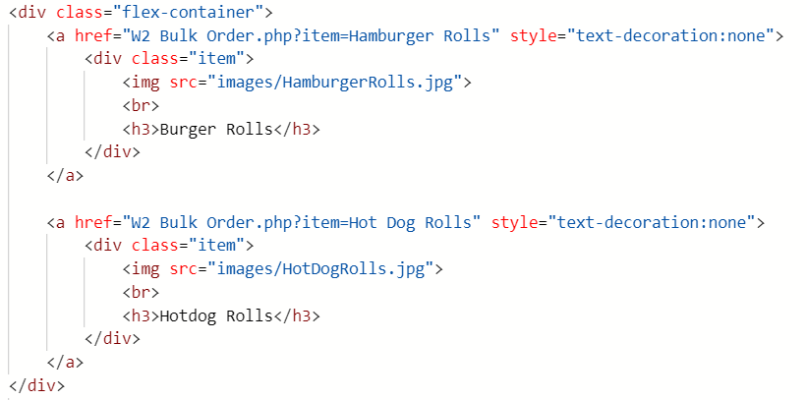
HTML Code
Flex boxes
Different classes for CSS
Get sent with item parameter

Slide 9
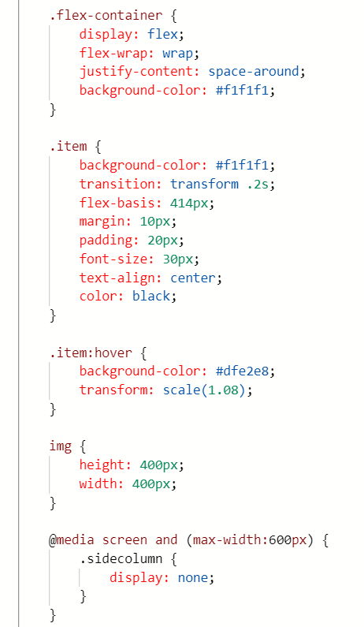
CSS Code
Flex boxes explained
Will automatically resize
Transition
Hover over
Max width

Slide 10
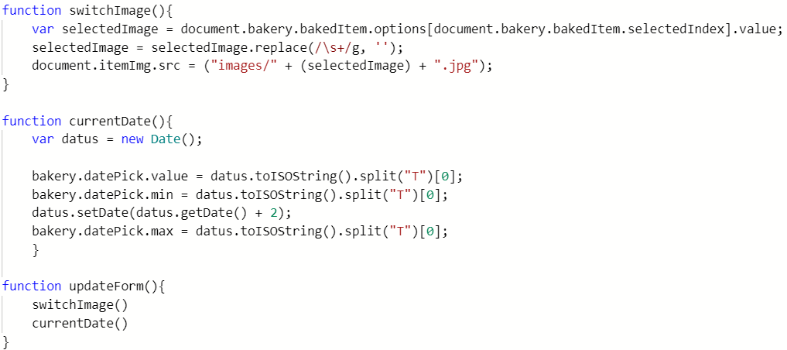
JavaScript Code
Switch the current image
Limits the pick-up options
Run functions at startup

Slide 11
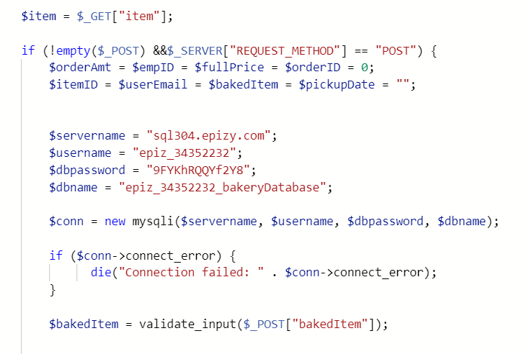
PHP Code
GET displays in URL
POST means form input
Enter database details

Slide 12
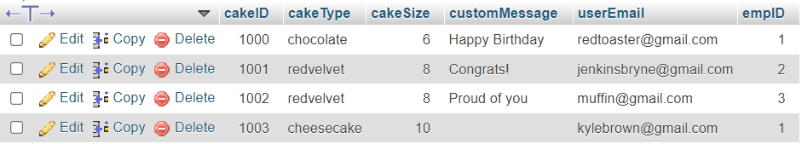
Table example
Unique ID for each order
Employee ID
Can be reused

Slide 13
Thank you for watching

